Slide 1
Main menu: (use case – Start a new pub list/Add the name of a town for the new pub list)
Choose the town you want to edit from the dropdown, or enter a new town name and create it:
▲
Aberystwyth
Borth
Enter town name:
Create town
Create town and add pubs
▼
Continue
Notes:
After selecting an option from the list the selected option will be highlighted to make it obvious what you have currently selected

Slide 2
Adding pubs to a list: (use case – edit a current pub list)
You are currently adding pubs to Aberystwyth’s list.
Name:
Description:
▲
▼
GPS Coordinates:
Choose location
Characteristics:
Select a characteristic…
True
False
▼
You have added the following characteristics: Dog Friendly, Real Ale
Photos:
Manage Photos
Back
Save changes and return to Menu
Add next pub
Notes:
Pressing back to menu should give a warning message letting the user know that their changes will be lost. Should also highlight areas which the user has not filled in correctly and provide helpful messages, eg “You must upload a photo”. After designing this page I think it looks a little crowded, might be worth separating
Over multiple pages, separate page for photos and characteristics maybe? Pressing manage photos will open a popup window allowing users to add photos. Return to Menu should take the back to the main menu if they added a new pub, or back to the edit list page if they were editing a specific pub list.

Slide 3
Editing an existing pub list: (use case – Edit a current pub list)
You have loaded Aberystwyth’s list.
Please select a pub from the list that you would like to edit or delete. Alternatively you can choose to add a new pub.
▲
The Cambrian
Bar 46
Yr Hen Orsaf
Add a new Pub
Edit Selected Pub
Delete Selected Pub
▼
Back
Notes:
After selecting a pub that pub will be highlighted to let the user know it has been successfully selected

Slide 4
Editing a pub: (use case Editing the details of an existing pub)
You are currently editing The Cambrian.
Name:
The Cambrian
Description:
A student focused bar, equipped with a pool table and a wide selection of drinks, most created by various society's from the university.
▲
▼
GPS Coordinates:
Edit location
Characteristics:
Welsh
True
False
▼
You have added the following characteristics: Dog Friendly, Real Ale
Photos:
Manage Photos
Back
Save changes
Use case – Save the edited pub list, or discard the changes
Notes:
All of the textboxes will be disabled and interactable until the user selects a pub from the dropdown menu, at which point the textboxes will fill with the pubs details. Clicking manage photos will bring up a popup window, see next slide.
Only one of the true and false buttons will be enabled – if the characteristic is currently true, the true button will be disabled.

Slide 5
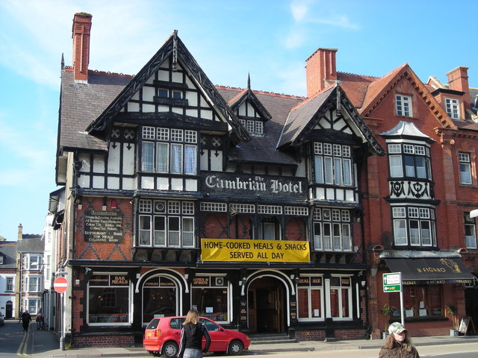
Manage photos:
Currently uploaded photos (max 5):
Currently viewing image: cambrian_outside.png
cambrian_outside.png
View
Remove
View
Remove
cambrian_inside.png
View
Remove
View
Remove
View
Remove
Add new photo:
Upload file
Choose file
Discard changes
Save and exit
Image reference: https://s0.geograph.org.uk/photos/38/15/381546_399f33a3.jpg
Notes:
After choosing a file it will be added to the list of photos, with its own delete button. Choosing to delete a photo will bring up a warning box with the options cancel and delete, letting the user know that

Slide 6

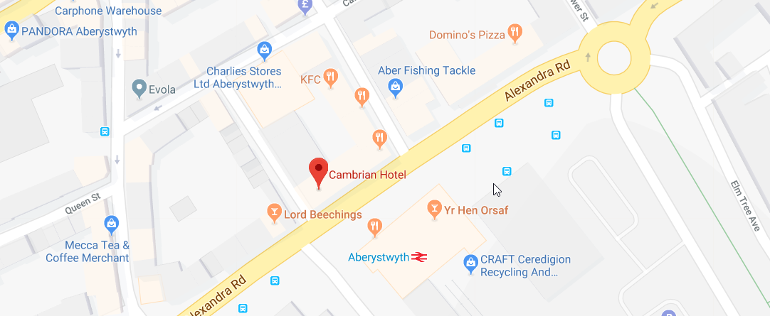
Edit/choose Location:
Please Select a Location:
Close without saving
Save and close
Image taken on google maps:
Notes:
When pressing Choose location and edit Location buttons this window will popup, allowing the user to browse google maps and select a location. The GPS coordinates of this location will be saved for future use. (Im sure we will be able to make the searchbar and the map display together naturally, after we do some more research on how to embed google maps)

